Slide 1

Face Exit Animation Template
Use the Offset X and Offset Y on the crop settings of the image to change the face.
To use this animation, copy and paste the nice job image to a duplicate of the slide to transition from. Then set the auto transition of the duplicated slide to the length of the animation of the image.

Slide 2
Face Entry Animation Template
Use the Offset X and Offset Y on the crop settings of the image to change the face.
To use this animation, copy and paste the nice job image to the slide.
The image is hidden on this slide so that you can read this.

Slide 3
Mandatory Slides for 10-20-30
[Conrad] Additional presentation artwork
Title Page
[Caleb] Problem / Opportunity
[Caleb] Value Proposition (push - right)
[Caleb] Underlying Magic (face – nice job)
[Jon] Business Model (push - up)
[Jon] Go To Market Plan (push - right)
[Jon] Competitive Analysis (face - wowza)
[Conrad] Management Team (Morph)
[Zeki] Financial Projections and Key Metrics
[Zeki] Current Status, Accomplishments to Date, Time Management and Use of Funds

Slide 4
Construction Chaos
By Ken Struction Studios

Slide 5
Opportunity

Slide 6
Value Proposition

Slide 7
Value Proposition

Slide 8
Underlying Magic

Slide 9
Demonstration

Slide 10
Demonstration

Slide 11







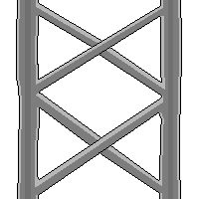

Demo 2

Slide 12



Competitive Analysis

Slide 13

Management Team

